Slide 1

Making the Most of Your Course Tools
Connect® Course Resources for MATH 1019

Slide 2

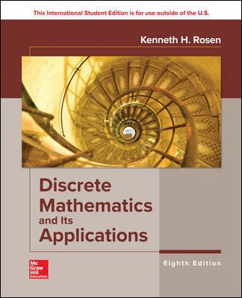
About Your Course
Course Code: MATH 1019
Resource: Discrete Mathematics and it's Applications, 8/e
Author: Rosen
Course URL: https://connect.mheducation.com/class/j-edmonds-fall-2023-sec-a
Connect is required for a % of your course grade
Need help logging in?
Click here to speak with our
Digital Technical Support team

Slide 3

Why Connect?
Connect
Connect Free Trial: Get FREE 14-day access to Connect. Register now at your instructor’s course URL for limited time access.
Connect is your personalized digital learning platform that makes studying and getting work done easier and more convenient than ever.
Maximize your study time with a personalized learning path.
Save time – access assignments & learning tools in one place.
Achieve better grades & track your progress.
Learn online or offline, anytime, anywhere.

Slide 4
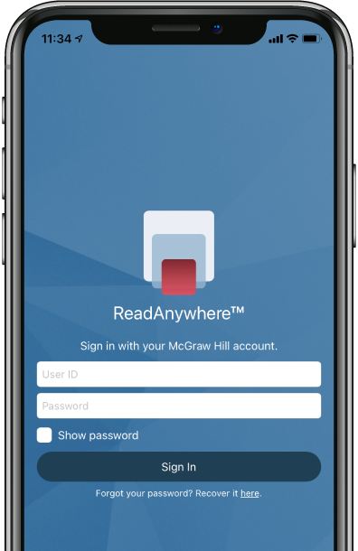


Readanywhere App
The FREE ReadAnywhere App makes it easy to read your Connect eBook on your smartphone or tablet so you can study anywhere, anytime.
Complete SmartBook assignments
Listen to your textbook with audio functionality
Sync assignments & notes
Download & read chapters
Work online or offline
Highlight and take notes
Download Now

Slide 5

Purchase Options
Connect
McGraw Hill offers a variety of purchase options so you can choose the flexible course materials that suit your learning style.
Print + Connect Package
Connect Online Access
+ Optional Upgrade
Bookstore: $129.95
You will receive a Connect access card, plus colour, print bound version of the complete text.
Online: $99.00
Bookstore: $99.00
Online: $30.00
Available within your paid Connect account, purchase a loose-leaf version of the print text.

Slide 6
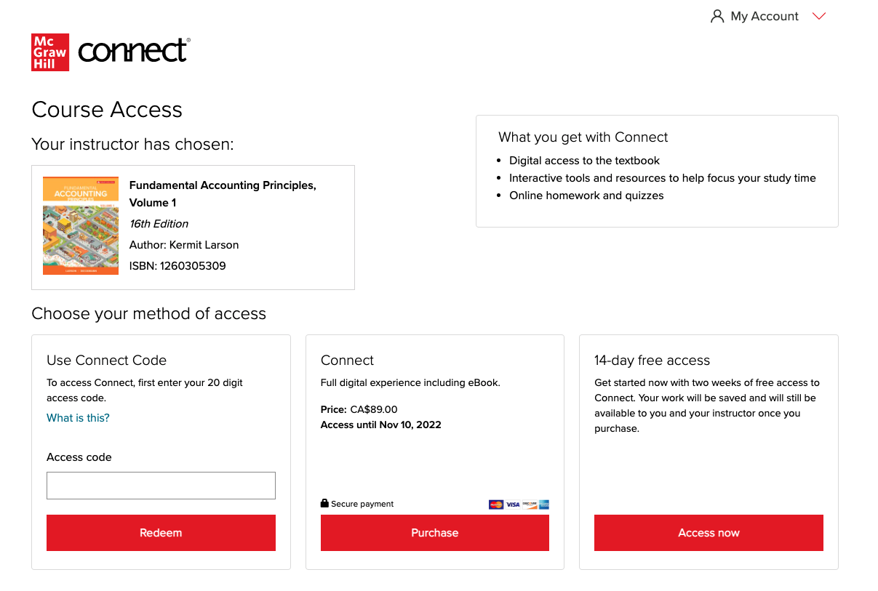
How to Register
Registration
with an Access Code
After you have purchased Connect or Connect + Print Text from your bookstore or mheducation.ca, go to your Connect Course URL and follow the steps below:
STEP 1: Enter your institution email and sign in or register for a new account.
STEP 2: Enter your 20-digit Connect access code you have pre-purchased from the bookstore or mheducation.ca
STEP 3: If you have not already purchased a Connect access code, you can choose [Buy It] for immediate full access, or get a 14-day FREE TRIAL for limited time access
Click here for a quick registration tutorial

Slide 7

Best Practices
Connect
Use Google Chrome as your internet browser
Clear your browser cache prior to the start of an assignment, simulation, quiz or exam.
Complete a Computer Compatibility Check.
Complete the assignment, simulation, quiz or exam on your laptop or desktop rather than a mobile device.
Reminders
Connect should be loaded on ONE session of your browser and only ONE tab within your browser.
Use an ethernet cable to directly connect your device to your internet modem for faster speeds.
Limit the number of applications running and devices connected to your wireless internet while completing your assignment.

Slide 8

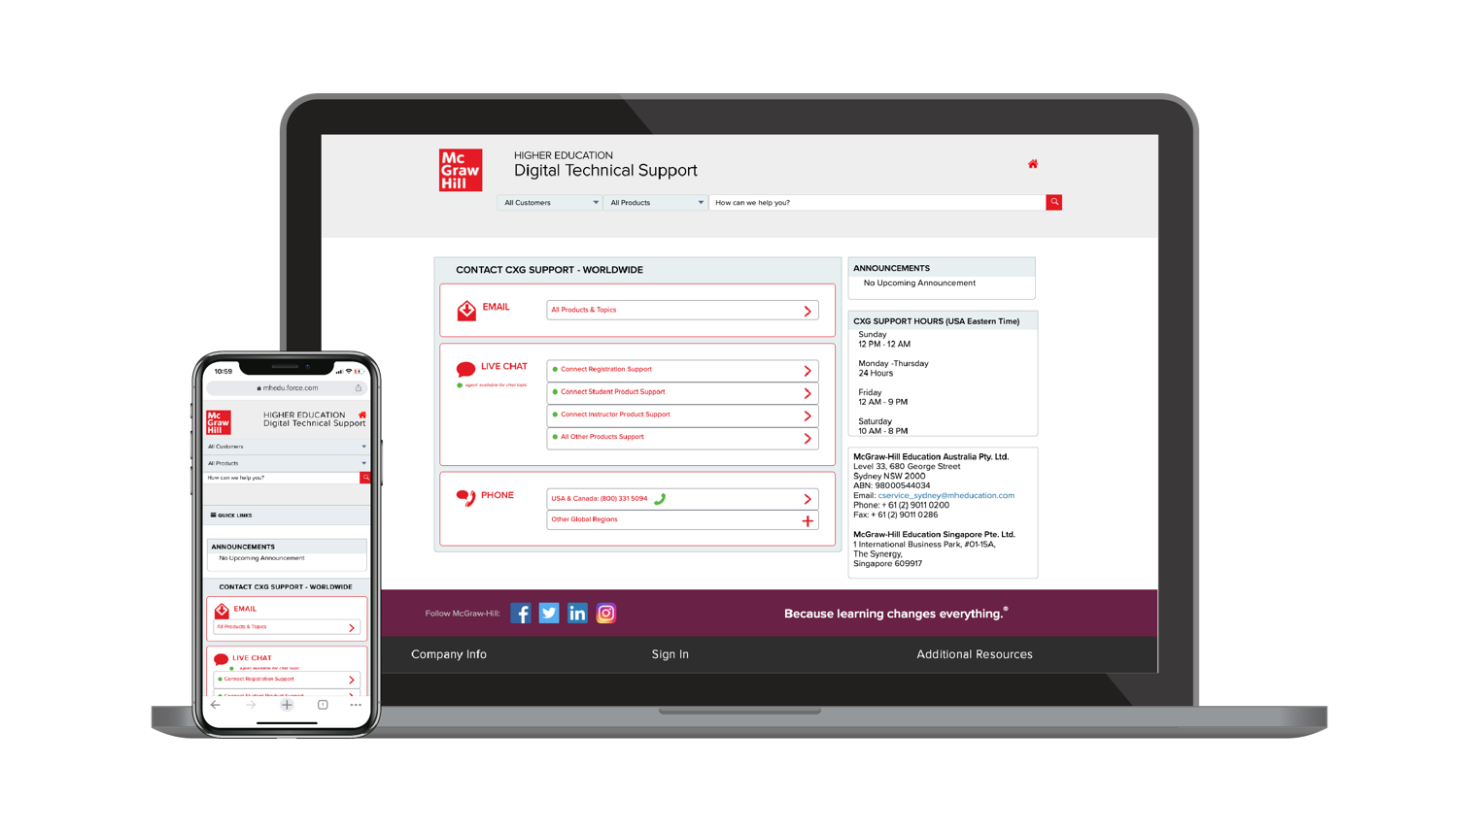
Accessibility & Support
Connect
Accessibility
Support Hours (ET)
If you have any questions or concerns about interacting with our products, please contact your institution’s Accessibility Office.
Sunday
12 PM – 12 AM
Monday – Thursday
24 Hours
Friday
12 AM – 9 PM
Saturday
10 AM – 8 PM
Support
We’re here to help. If you need technical help with Connect, get in touch with our experts:
Phone: (800) 331 5094 (USA & Canada)
Web: Get in touch

